Slide 1

Library System
DATA STRUTURES AND ALGORITHAMS
NIBM
MAHDSE212f015
MAHDSE212f016
MAHDSE212f005

Slide 2
In Our System
We decided to build console application for library system.
In the library system we can see so many algorithms
In the book Waiting list
Book borrowing history
In this application we use new technologies ,algorithms and file handling.
& we use oop concepts,getch() ,setw()s,system clears and system colors.

Slide 3
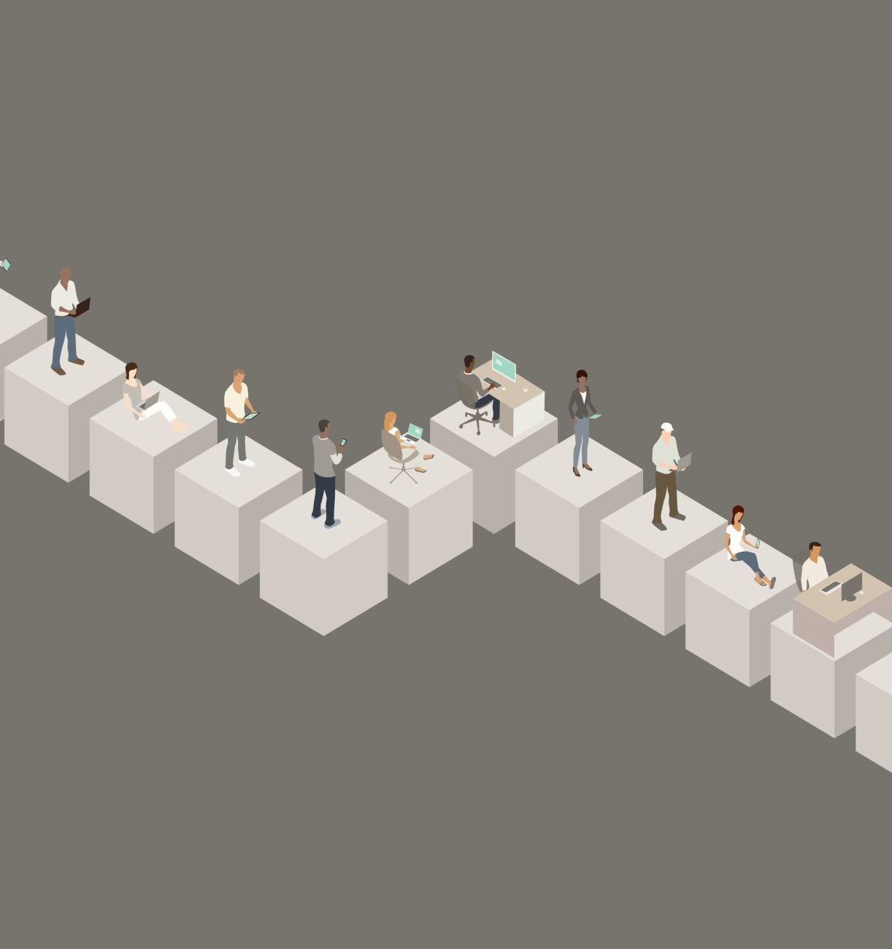

classes
Queue
Account
Admin
Student

Slide 4

Account
There are 2 type of accounts.
Admin
Student
There are varies privileges for each account type.
Anyone can create Student account but there is a password need for create admin account.
Admin can add ,delete and edit details in the system.
Students only can look for a book list and request book.

Slide 5

Student
When the student request ,system read files in system and look for availability of requesting book.
Each one of book has a waiting list and they are based on queue algorithms
Files are auto generate using relevant book name

Slide 6

Student
01.Book List
02.Reservant Book

Slide 7

Admin
Admin can access most of the paths in the application.
Add book , edit book, delete book ,add student , edit student ,delete student and issuing books are available in this class.

Slide 8
Admin
01.Add Book
02.Delete Book
03.Edit Book
04.Add Student
05.Delete Student
06.Edit Student
07.giving books

Slide 9

Queue
This algorithms allow to controls data and flow in students and admin.
When the who comes first and request first allow to barrow book first.

Slide 10
Thank you!!

